Slide 1
Danica Ito
AP Photo 2010

Slide 2
Breadth

Slide 5
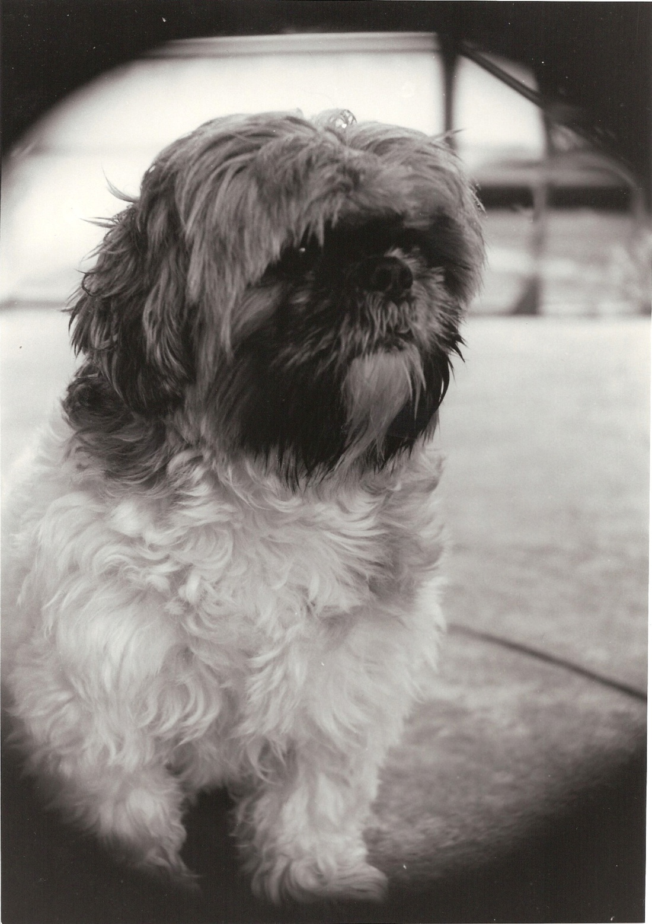

Slide 7
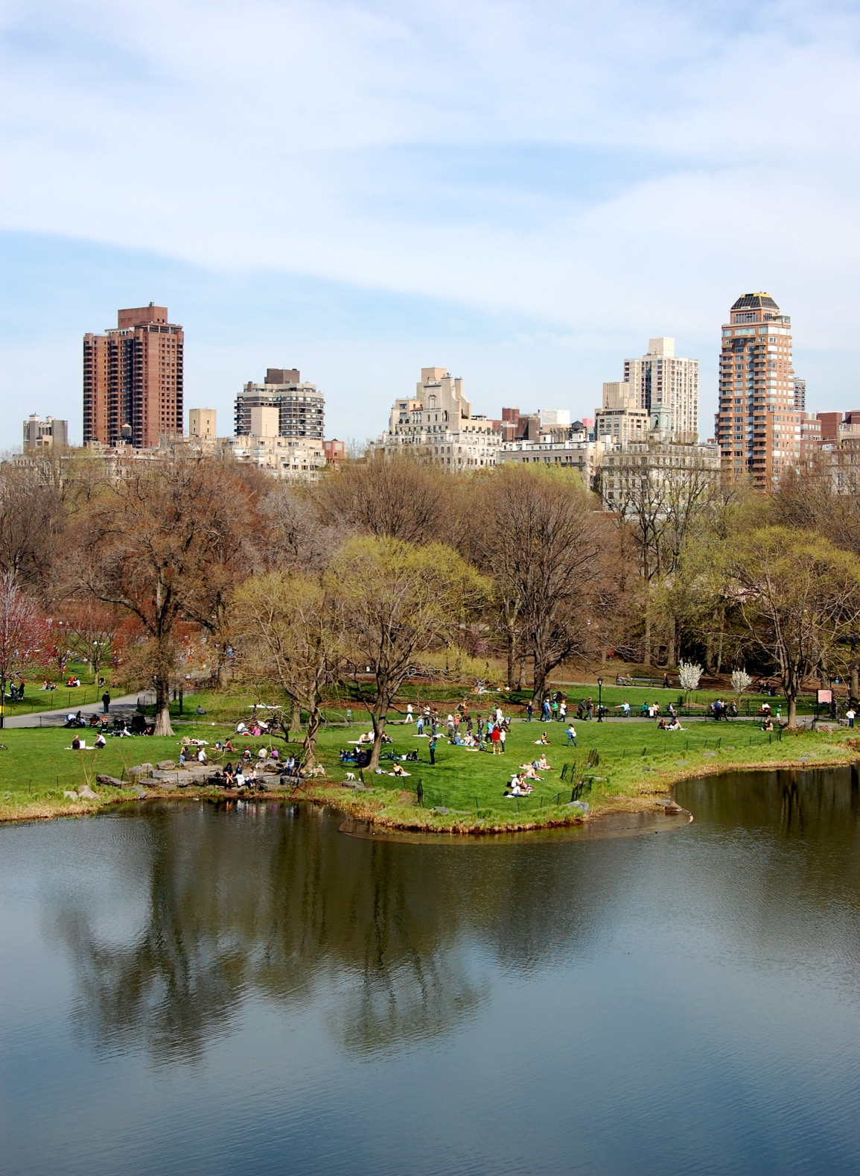

Slide 8
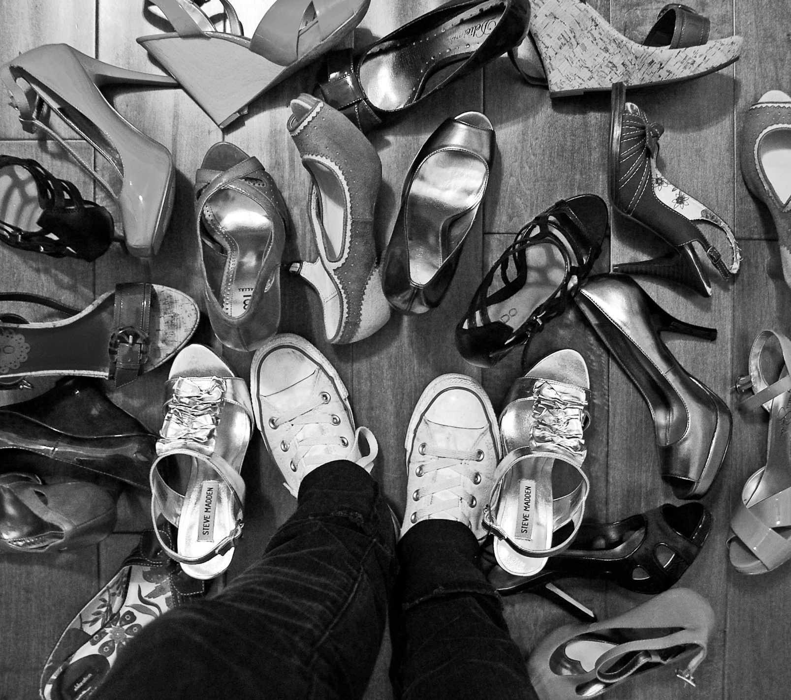

Slide 11
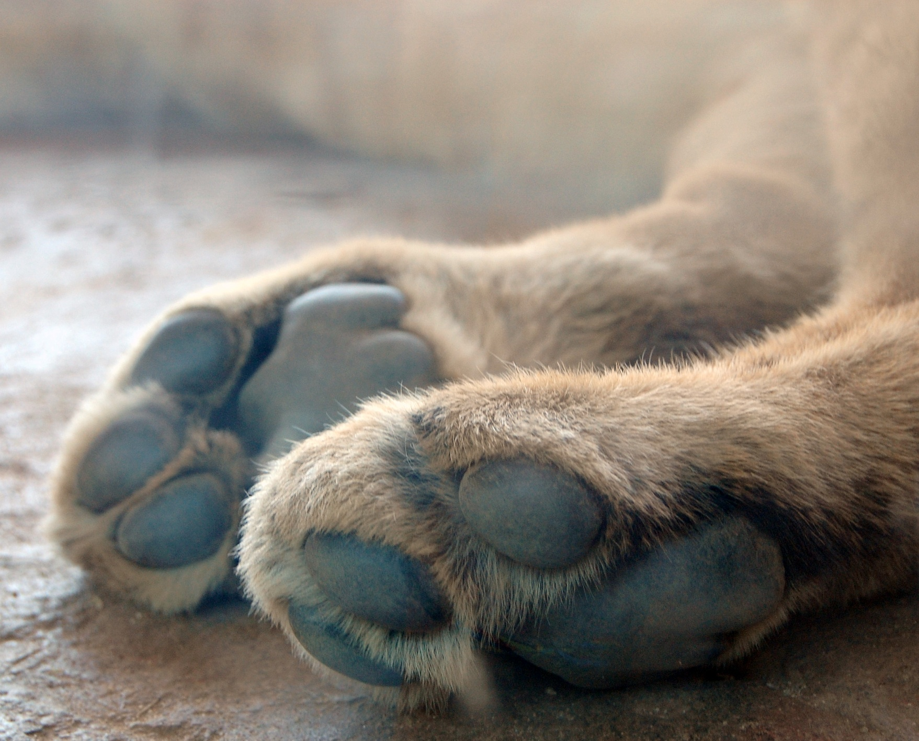

Slide 13
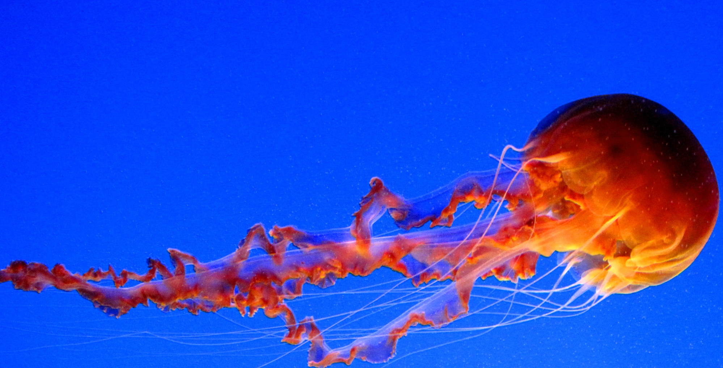

Slide 15
Concentration

Slide 16
Concentration Commentary
1. Water is a one of the world’s most valuable resources. It provides beauty, energy, entertainment, means of travel, and most importantly life. Without water life on earth would not be possible. It provides for us in so many different ways, including being a source of fun and entertainment. Water offers us many options for recreational fun. Through our interaction with water we can discover both enjoyment and appreciation.
2. Water provides many possibilities for fun and amusement. There are beaches, lakes, rivers, pools, and spas. We can go swimming, wakeboarding, surfing, boating, waterskiing, jet skiing, and so many more things. We do not have to be in or under the water to be able to enjoy it. We are able to enjoy water on land. We can have water balloon fights, experience the rain, and visit Sea World or an aquarium. The first half of my pictures explore various options for enjoying water on land and the last half show options for deeper immersion in water. Photograph one shows a group enjoying Sea World and admiring some of the wild life. Photograph three also portrays a group of people enjoying Sea World, but they are subjected to embrace the wet quality of water. This picture demonstrates the fluidity and freeness of form that water has. Pictures four and five exhibit content and form. The developer was used in such a way as to capture the way water sprays and forms droplets. Photograph ten shows how water can form to its container and can adjust to allow other objects to enter it easily. Picture seven demonstrates the power that water has behind it. We can use it to propel ourselves into the air. Water provides us with the thrill of flying through the air, organized sports, and exploring a world that only exists under its surface.

Slide 17
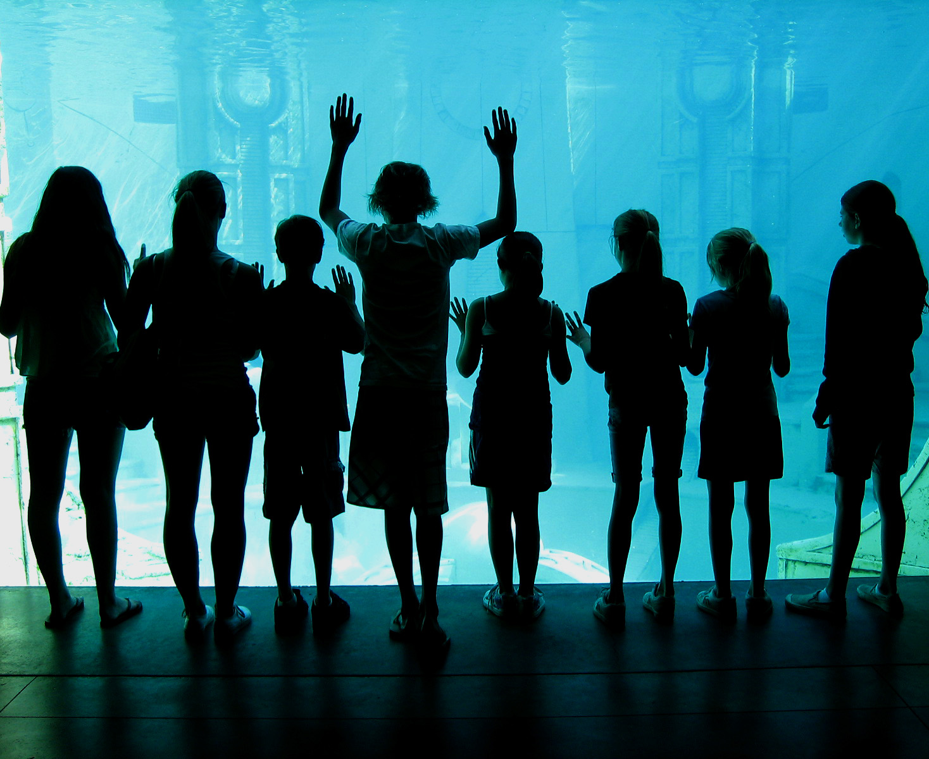

Slide 18
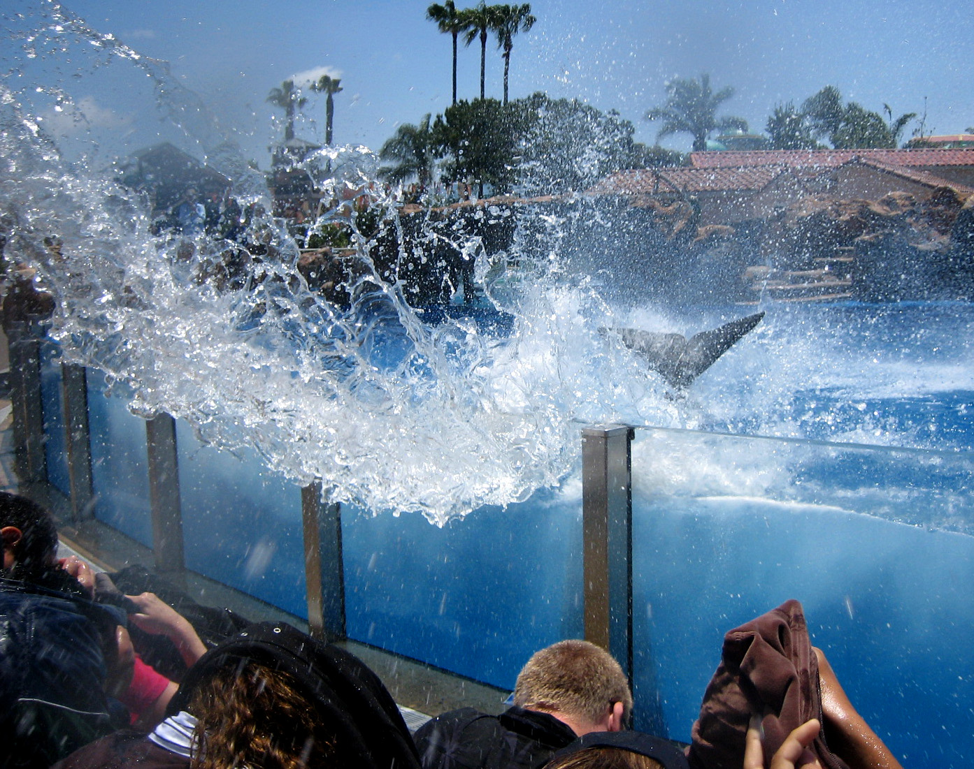

Slide 21
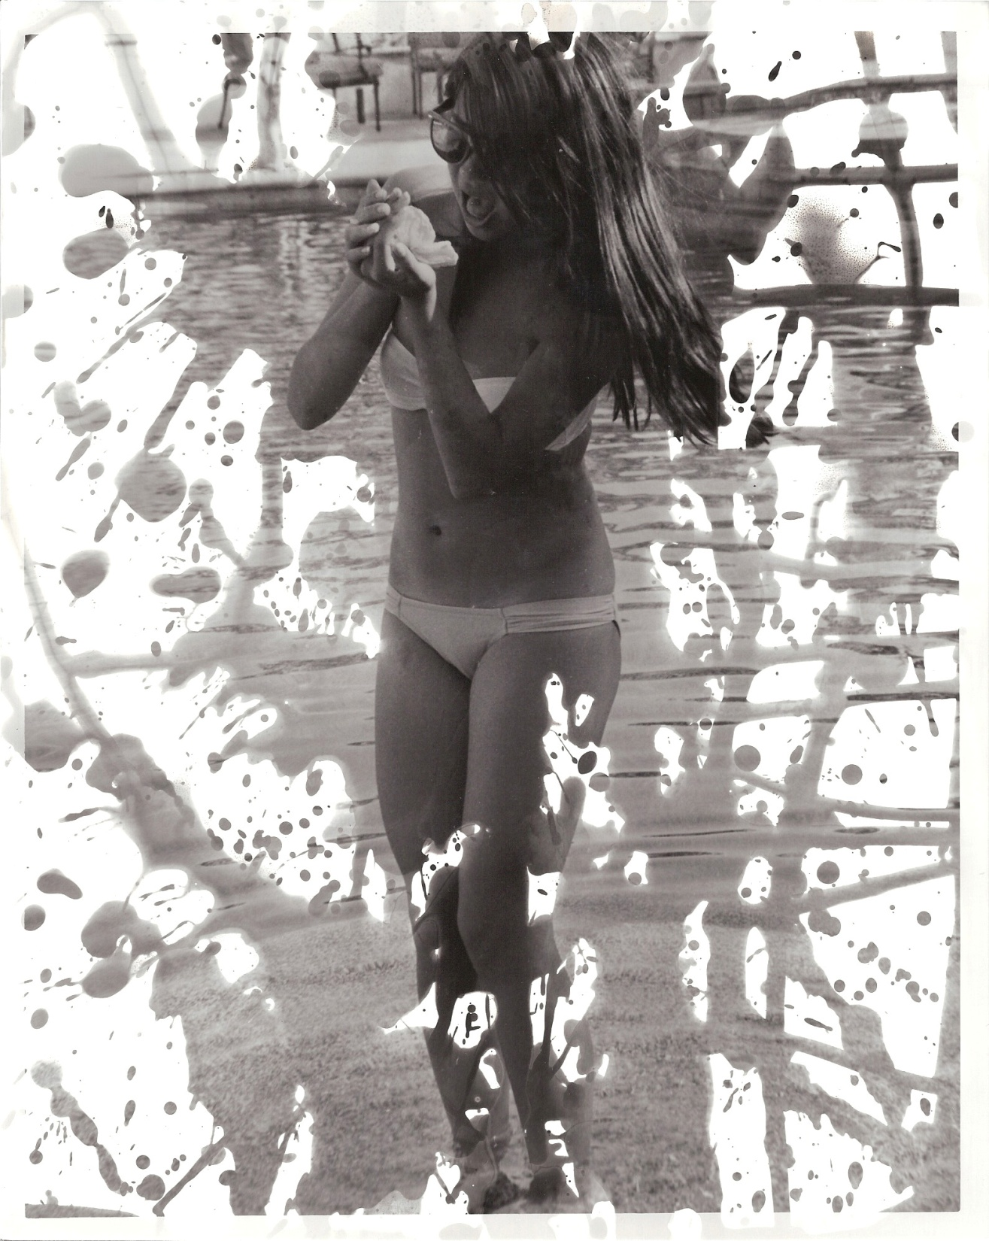

Slide 22
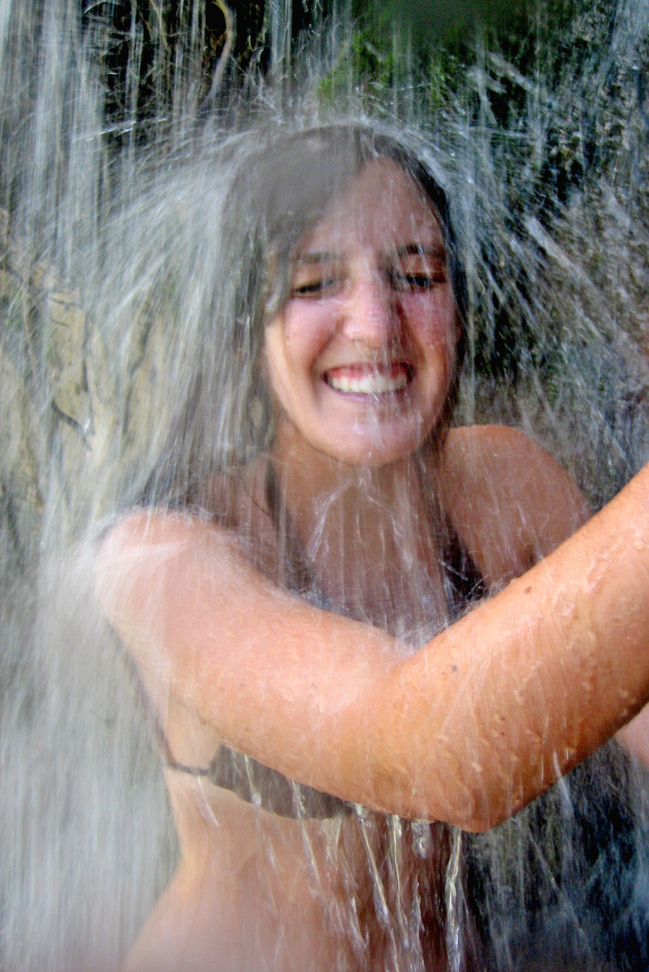

Slide 23
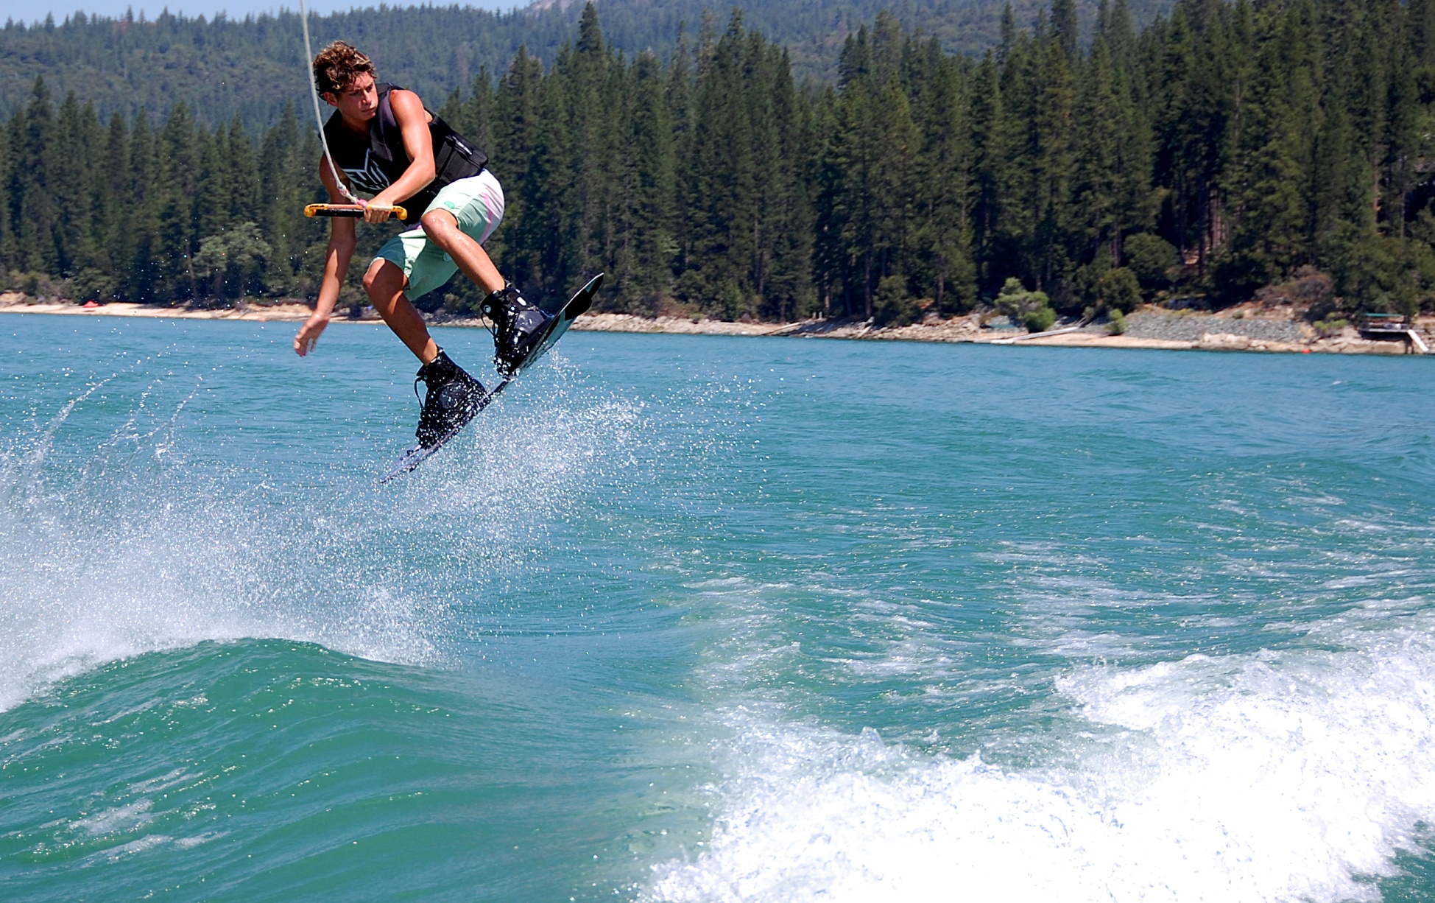

Slide 24
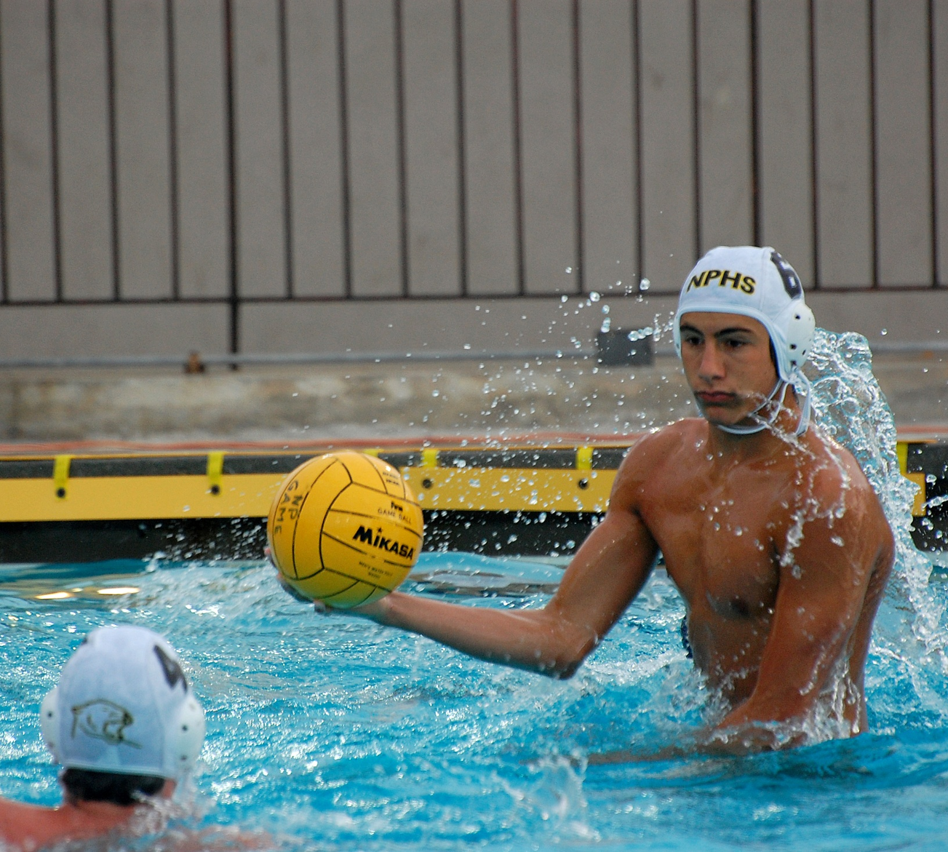

Slide 25
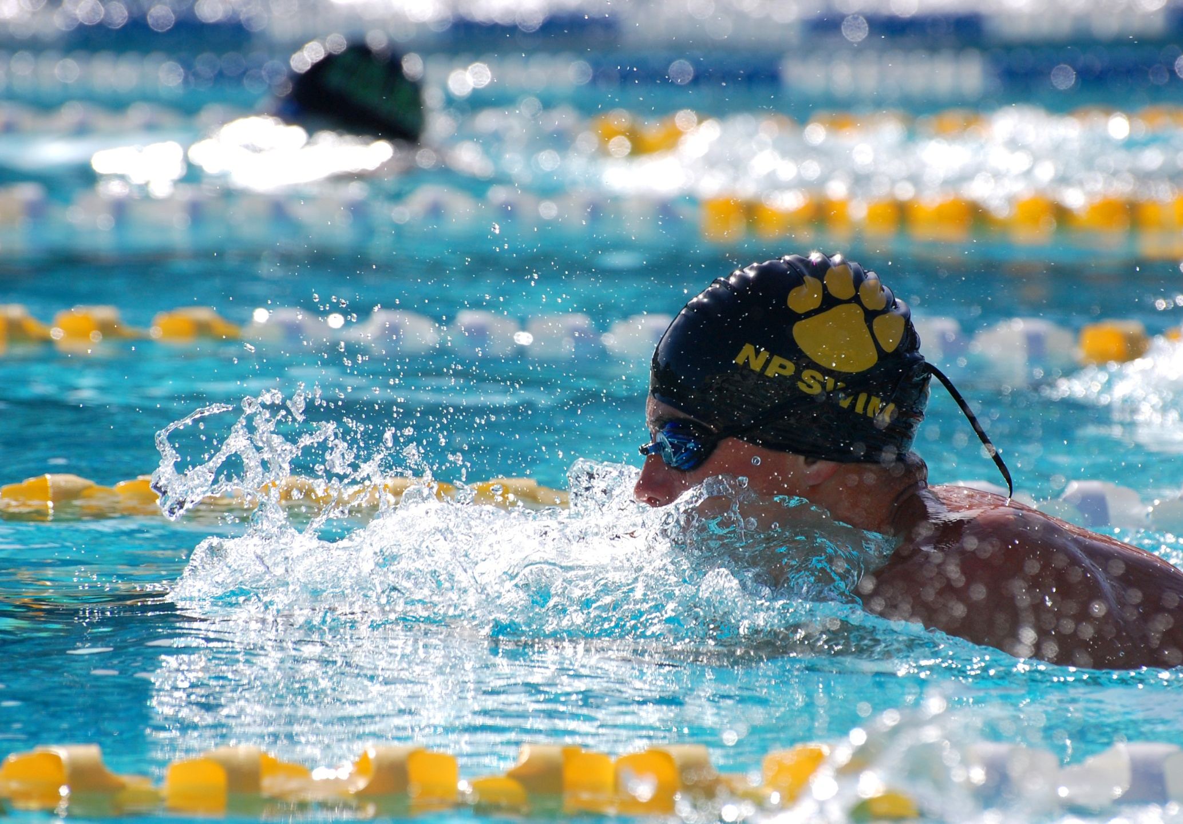

Slide 26
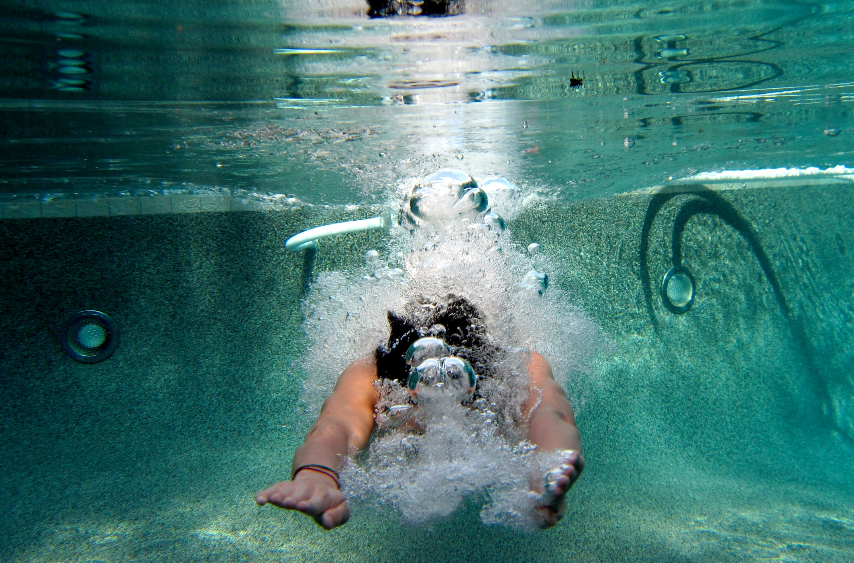

Slide 27
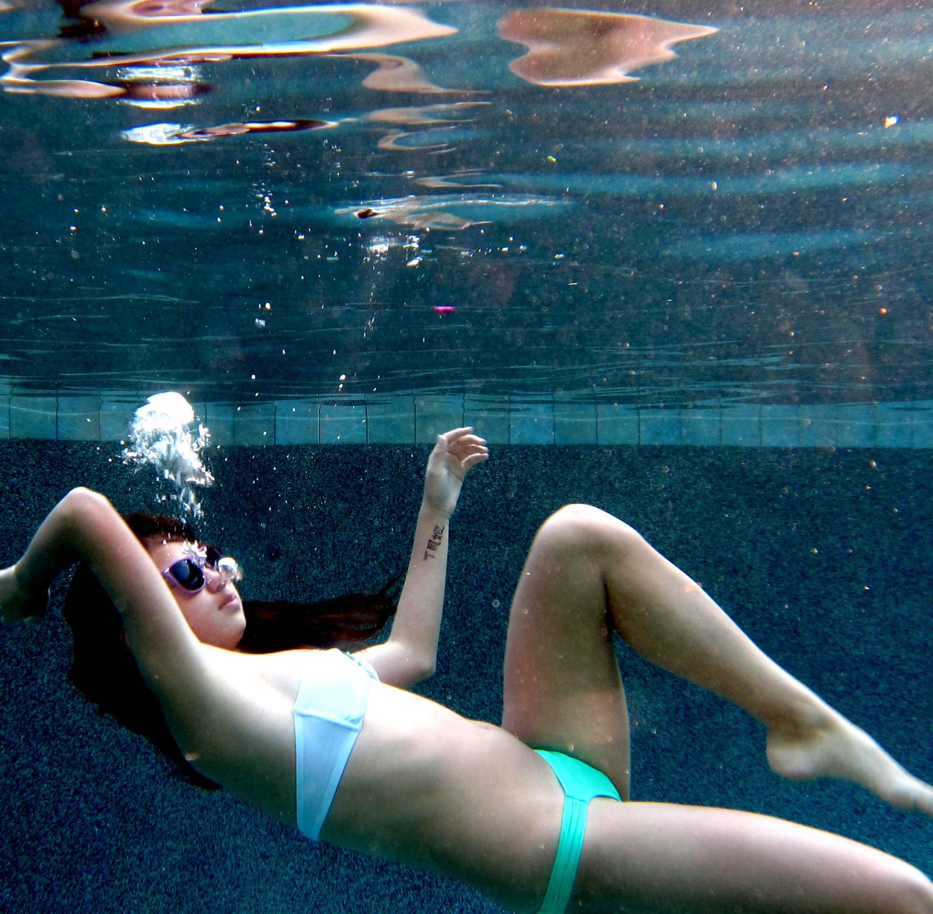

Slide 28
